Slide 1
BACKTRACKING

Slide 2
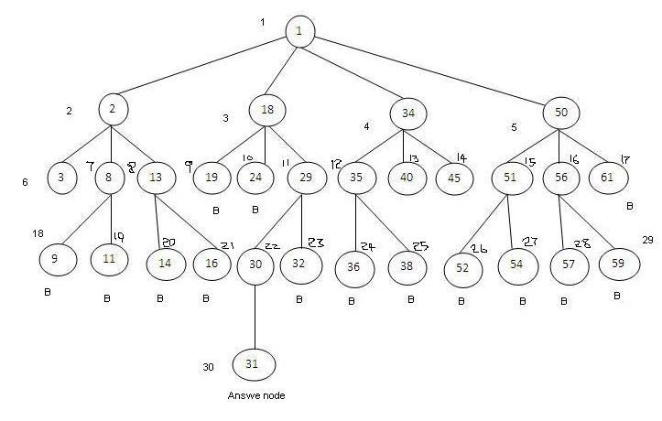
BACKTRACKING

Slide 3
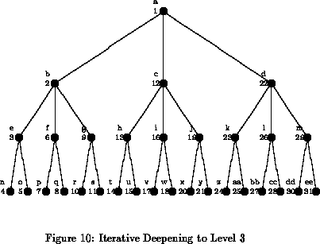
BACKTRACKING

Slide 4
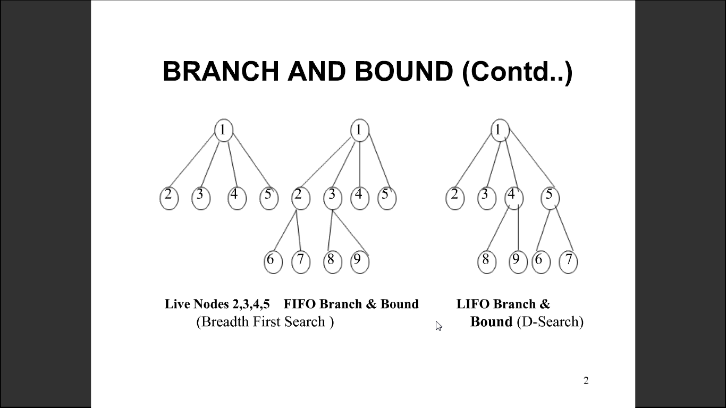
BACKTRACKING

Slide 5
BACKTRACKING
Backtracking is one of the most general algorithm design techniques.
Many problems which deal with searching for a set of solutions or which ask for an optimal solution satisfying some constraints can be solved using the backtracking formulation.

Slide 6
BACKTRACKING
In many applications of the backtracking method, the desired solution must be expressible as an n-tuple ( x₁, …., x_{n} ) where x_{i} is chosen from some finite set S_{i}.
Often the problem to be solved calls for finding one vector that maximizes ( or minimizes or satisfies ) a criterion function P( x₁, …., x_{n} ).
Suppose m_{i} is the size of set S_{i}. Then there are m = m₁, …….…, m_{n} n-tuples that are possible candidates for satisfying the function P.

Slide 7
BACKTRACKING
Backtracking basic idea is to build up the solution vector one component at a time and to use modified criterion function P_{i}( x₁, …., x_{i} ) ( sometimes called bounding functions ) to test whether the vector being formed has any chance of success.
Advantage
The major advantage of this method is, if it is realized that the partial vector ( x₁, …., x_{i} ) can in no way lead to an optimal solution, then m_{i+1, …..,} m_{n} possible test vectors can be ignored entirely.

Slide 8
BACKTRACKING
Many problems we solve using backtracking require that all the solutions satisfy a complex set of constraints. These constraints are classified as:
Explicit constraints.
Implicit constraints.
Implicit constraints: The implicit constraints are rules that determine which of the tuples in the solution space I satisfy the criterion functions.
Thus the implicit constraints describe the way in which the x_{i} must relate to each other.

Slide 9
BACKTRACKING
Explicit constraints: Explicit constraints are rules that restrict each x_{i} to take values only from a given set. Some examples are,
x_{i} > 0 or S_{i} = { all non-negative real no }
x = 0 or 1 or S_{i} = { 0, 1 }
l_{i} x_{i} u_{i} or S_{i} = {a: l_{i} a u_{i} }
The explicit constraints depend on the particular instance I of the problem being solved.
All tuples that satisfy the explicit constraint define a possible solution space for I.

Slide 10
BACKTRACKING
Backtracking algorithms determine problem solutions by systematically searching the solution space for the problem instance.
This search is facilitated by using a tree organization for the solution space.
For a given solution space many tree organizations may be possible.
Each node in the combinatorial tree defines a problem state.
All paths from the root to other nodes define the state space of the problem.
Solution states are those problem states 's' for which the path from the root to 's' defines a tuple in the solution space.

Slide 11
BACKTRACKING
Answer states are those solution states 's' for which the path from the root to 's' defines a tuple that is a member of the set of solutions ( i.e., it satisfies the implicit constraints) of the problem.
The tree organization of the solution space is referred to as the state space tree. State space tree organizations are two types.
Static trees.
Dynamic trees.
Tree organizations that are independent of the problem instance being solved are called static trees.
Tree organizations that are problem instance dependent are called dynamic trees.

Slide 12
BACKTRACKING
Once a state space tree has been conceived of for any problem, this problem can be solved by systematically generating the problem states, determining which of these are solution states, and finally determining which solutions states are answer states.
There are two fundamentally different ways to generate the problem states.
Both of these begin with the root node and generate other nodes.

Slide 13
BACKTRACKING
A node which has been generated and all of whose children have not yet been generated is called a live node.
The live node whose children are currently being generated is called the E-node (node being expanded).
A dead node is a generated node, which is not to be expanded further or all of whose children have been generated.
In both methods of generating problem states, we have a list of live nodes.

Slide 14
BACKTRACKING
In the first of these two methods as soon as a new child C of the current E-node R is generated, this child will become the new E-node. Then R will become the E-node again when the sub-tree C has been fully explored. This corresponds to a depth first generation of the problem states.
In the second state generation method, the E-node remains the E-node until it is dead.
In both methods Bounding functions are used to kill live nodes without generating all their children.

Slide 15
BACKTRACKING
Depth first node generation with bounding function is called backtracking.
State generation methods in which the E-node remains the E-node until it is dead lead to branch-and-bound method.
A D-search (depth search) state space search will be called LIFO (Last In First Out) search, as the list of live nodes is a last-in-first-out list (or stack).

Slide 16
BACKTRACKING
Algorithm RBacktrack ( k )
// On entering, the first k – 1 values x[ 1 ], x[ 2 ], ……, x[ k-1 ] of the
// solution vector x[ 1 : n ] have been assigned. x[ ] and n are global.
{
for( each x[ k ] ∈ T ( x[ 1 ], x[ 2 ], ….., x[ k-1 ] ) do
{
if( B_{k}( x[ 1 ], ….., x[ k ] ) ≠ 0 ) then
{
if( x[ 1 ], ……, x[ k ] is a path to the answer node ) then
write( x[ 1 : k ] );
if ( k < n ) then RBacktrack( k+1 );
}
}
}

Slide 17
BACKTRACKING
Algorithm IBacktracking (n)
// All solutions are generated in x[ 1 : n ]& printed as soon as they
// are determined.
{
k := 1;
while( k ≠ 0 ) do
{
if ( there remains all untried x[ k ] ∈ T( x[ 1 ], x[ 2 ], …., x[ k-1 ] )
and B_{k}( x[ 1 ], ….., x[ k ] ) is true ) then
{
if( x[ 1 ], ……, x[ k ] is a path to an answer node) then write( x[ 1 : k ] );
k := k+1; //consider the next step.
}
else k := k-1; //consider backtracking to the previous set.
}
}

Slide 18
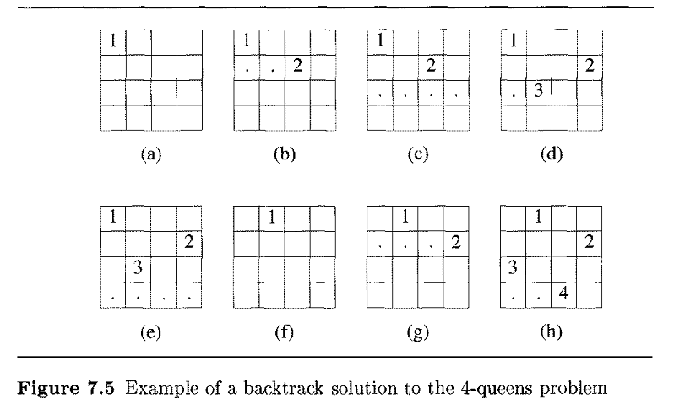
N - Queens

Slide 19
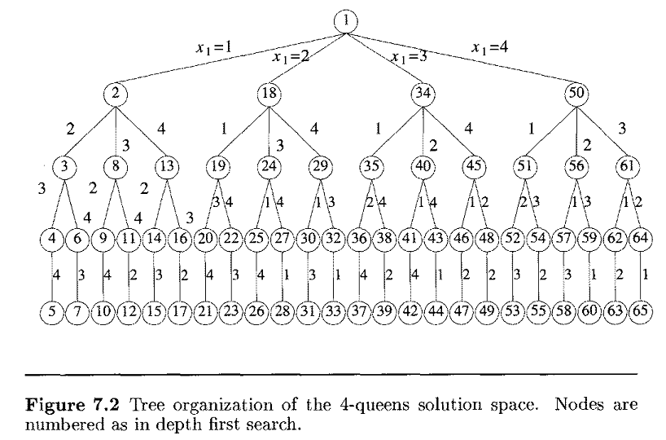
N - Queens

Slide 20
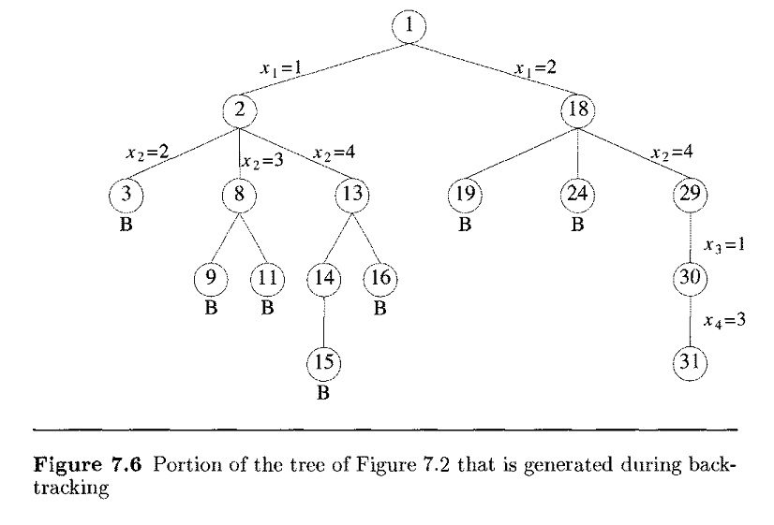
N - Queens

Slide 21
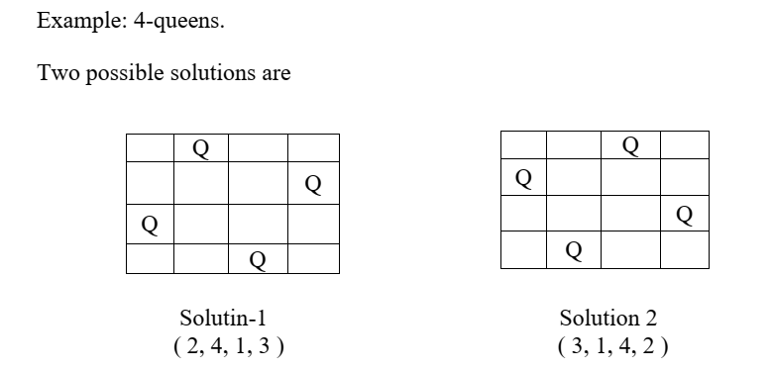

Slide 22
N - Queens
If we imagine the squares of the chessboard being numbered as the indices of the two dimensional array A[ 1:n, l:n ] then we observe that for every element on the same diagonal which runs from the upper left to the lower right, each element has the same "row - column" value.
Also, every element on the same diagonal which goes from the upper right to the lower left has the same "row + column" value.
Suppose two queens are placed at positions ( i, j ) and ( k, l ).

Slide 23
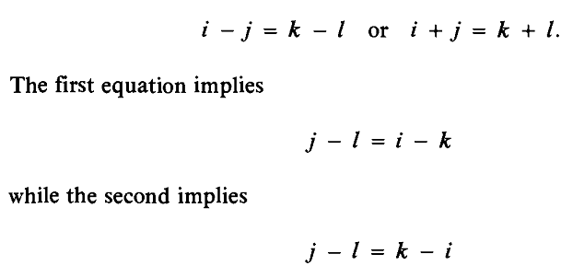

N - Queens
Then by the above they are on the same diagonal only if
Therefore two queens lie on the same diagonal if and only if
| j – l | = | i – k |.
The total number of nodes in the 8-queens state space tree is

Slide 24
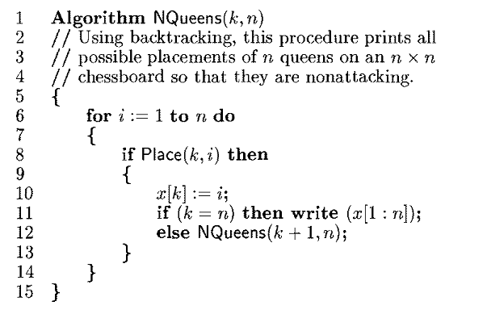
N - Queens

Slide 25
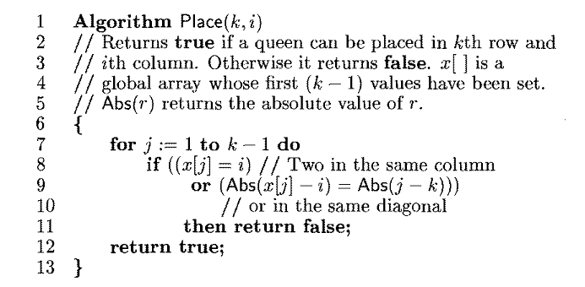
N - Queens

Slide 26
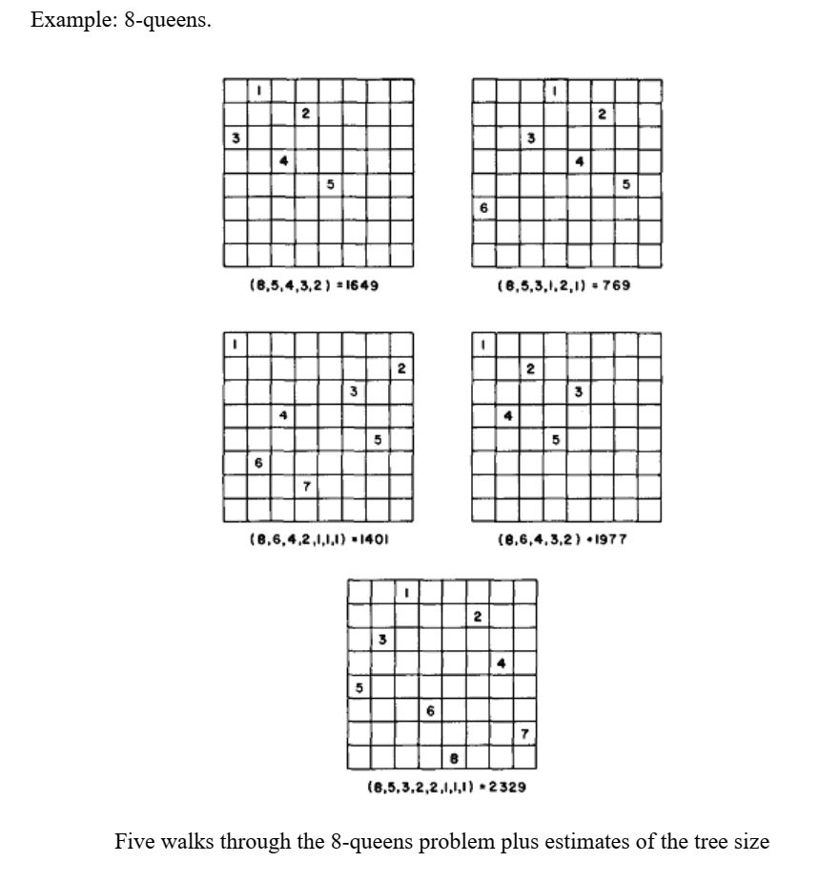

Slide 27
SUM OF SUBSETS
Suppose we are given n distinct positive numbers (usually called weights) and we desire to find all combinations of these numbers whose sum are m. This is called the sum of subsets problem.
This problem can be solved using either fixed or variable size Tuples.
We will consider a backtracking solution using the fixed tuple size Strategy.

Slide 28

SUM OF SUBSETS
In this case the element x_{i} of the solution vector is either one or zero depending upon whether the weight w_{i} is included or not.
For a node at level i the left child corresponds to x_{i} = 1 and the right to x_{i} = 0.
A simple choice for the bounding functions is B_{k}( x₁, …., x_{k} ) = true iff

Slide 29

SUM OF SUBSETS
Clearly x₁, …., x_{k} cannot lead to an answer node if this condition is not satisfied.
The bounding functions may be strengthened if we assume the w_{i}’s are initially in nondecreasing order. In this case x₁, …., x_{k} cannot lead to an answer node if

Slide 30
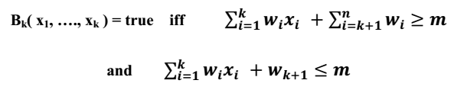
SUM OF SUBSETS
The bounding functions we shall use are therefore
Since our algorithm will not make use of B_{n}, we need not be concerned by the appearance of w_{n+1} in this function.

Slide 31
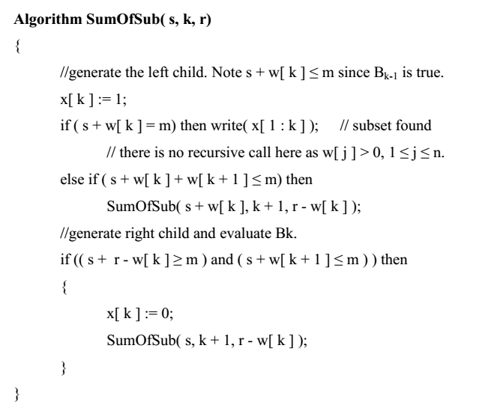
SUM OF SUBSETS

Slide 32
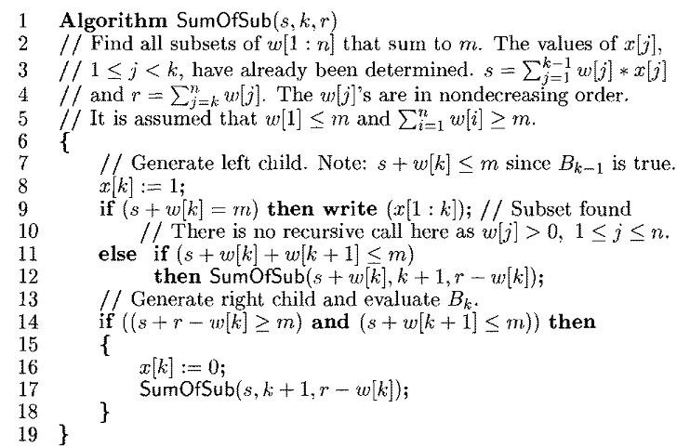
SUM OF SUBSETS

Slide 33
SUM OF SUBSETS
The explicit constraints require x_{i} ∈ { j | j is an integer and 1 ≤ j ≤ n }.
The implicit constraints require that no two be the same and that the sum of the corresponding w_{i}’s be m.
Another implicit constraint that is imposed is that x_{i} < x_{i+1} , 1 ≤ i ≤ k .
Example:
Given n = 6, m = 30 and w( 1, …, 6 ) = ( 5, 10, 12, 13, 15, 18 ).We have to generate all possible combinations of subsets whose sum is equal to the given value m = 30.

Slide 34
SUM OF SUBSETS
In state space tree of the solution the rectangular node lists the values of s, k, r, where s is the sum of subsets, ’k’ is the iteration and ‘r’ is the sum of elements after ‘k’ in the original set.
In the state space tree, edges from level ‘i’ to ‘i+1’ are labeled with the values of x_{i}, which is either 0 or 1.
The left sub tree of the root defines all subsets containing w_{i}.
The right sub-tree of the root defines all subsets, which does not include w_{i}.

Slide 35
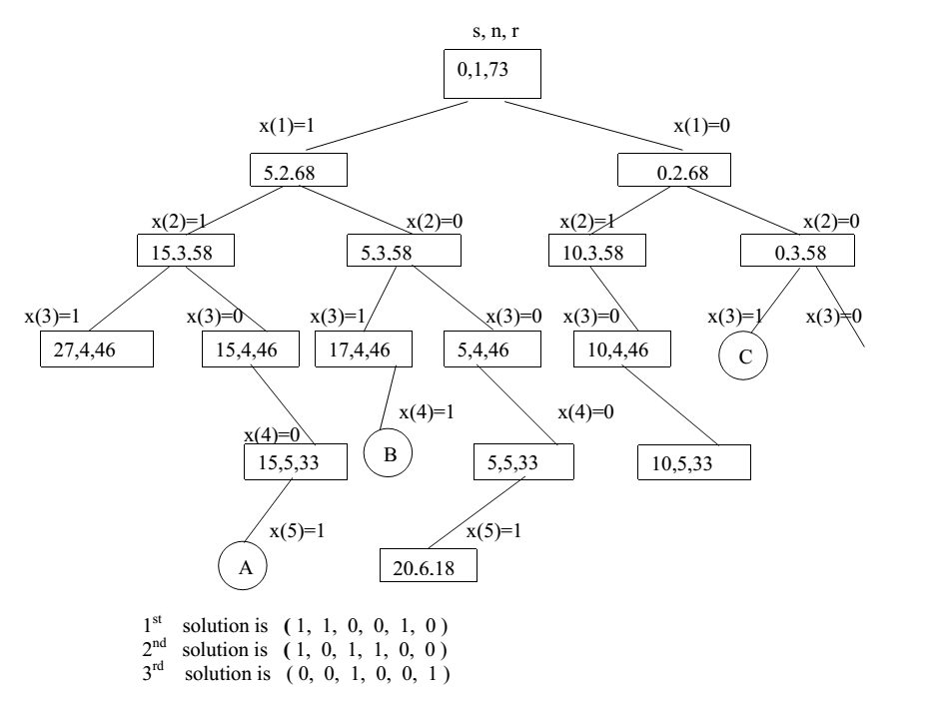
SUM OF SUBSETS

Slide 36
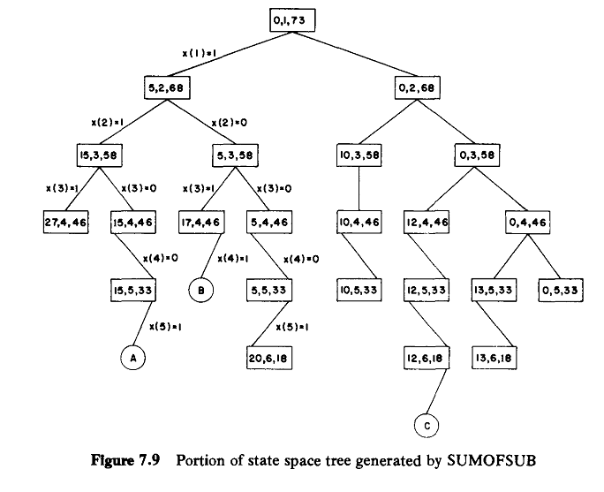
SUM OF SUBSETS

Slide 37
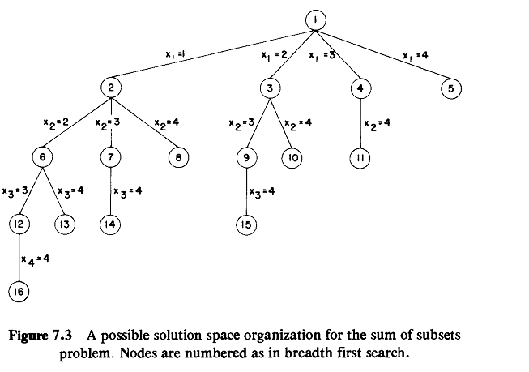

Slide 38
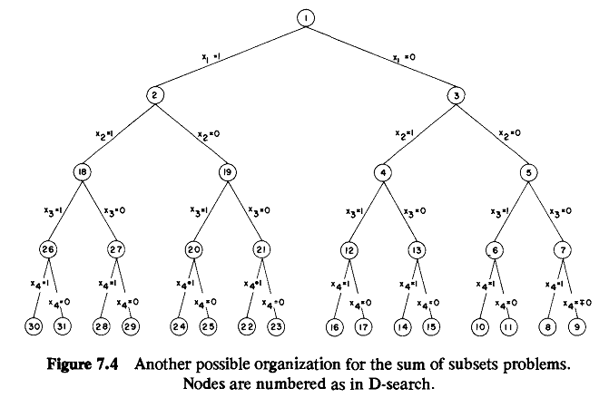

Slide 39
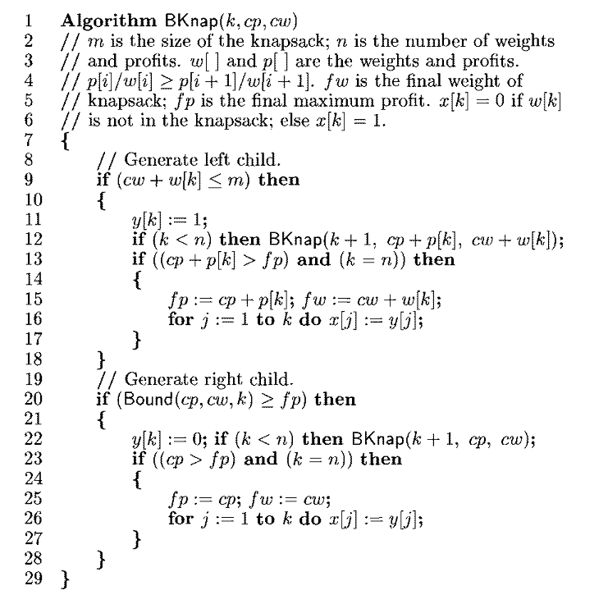
0/1 KnapSack Problem

Slide 40
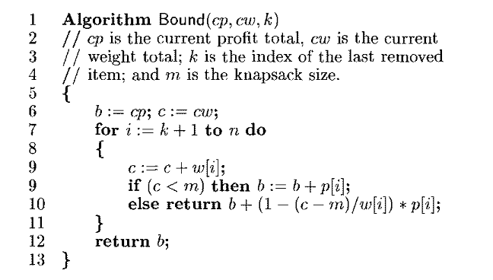
0/1 KnapSack Problem

Slide 41
